Slide 1

WolfConnect
Team: Manish Bhandari, Priyam Mishra, Yassin Dolliazal, Aydin Iverson, Amari Willis

Slide 2
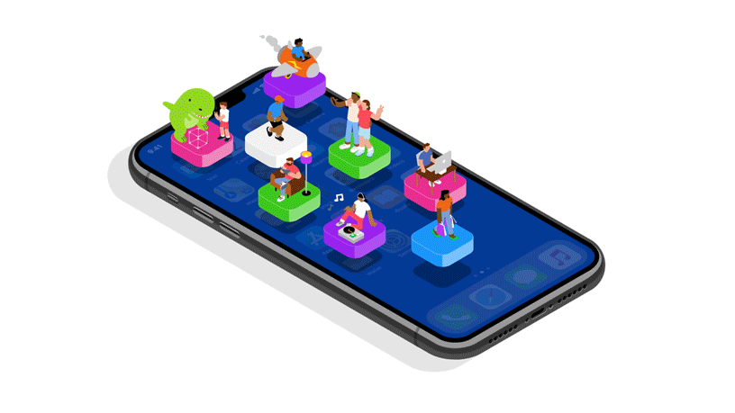
Problem - What’s the need?
Our school lacks a convenient app that congregates information such as scheduling, teacher information, and upcoming events. WolfConnect addresses the need for an easily accessible online hub for Westside High School through a mobile application.

Slide 3

Plan/Analysis - Scope
We envision that our application would be used by both students and teachers at our school. It will be an application that stores and displays essential information to people who use it. As such, we want to have a feature that displays the most recent HowlerTV news, allows users to access a calendar with updated events, and contains faculty information (like phone numbers and room numbers, including a bell schedule for the upcoming week).

Slide 4
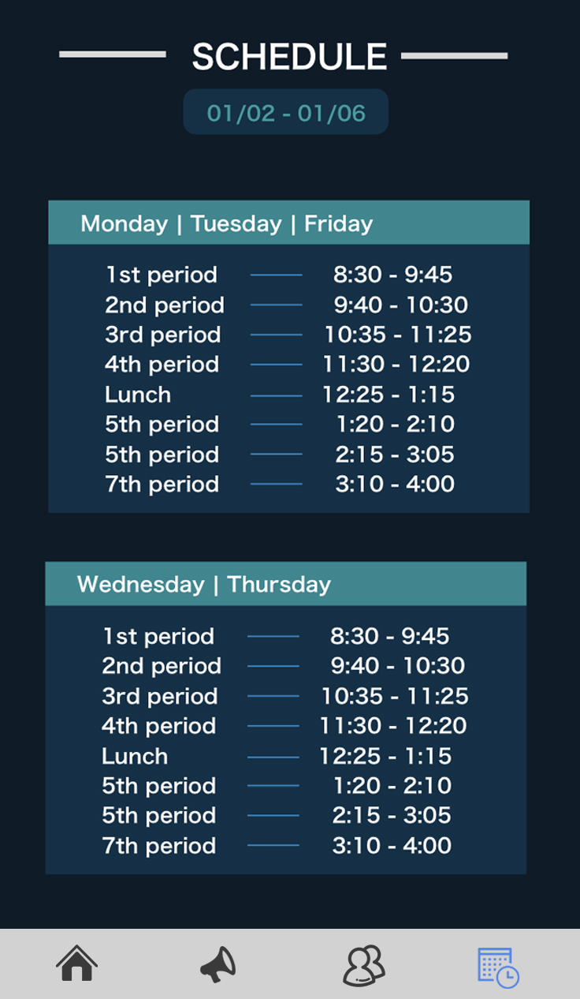
Design - Storyboard
Seamless user interface navigation
Tabbed view application: Clear navigation and maintain clarity
Up and down scroll: unifies all features and reduces unnecessary complexity
Simplicity & Consistency
Logical and concise design elements
Consistent layout and design allows users to develop usage patterns increasing fluidity and efficiency
Visual Hierarchy
Contrast between sizes, colors and placements of elements give a clear understanding of interface
Color choice and combinations

Slide 5


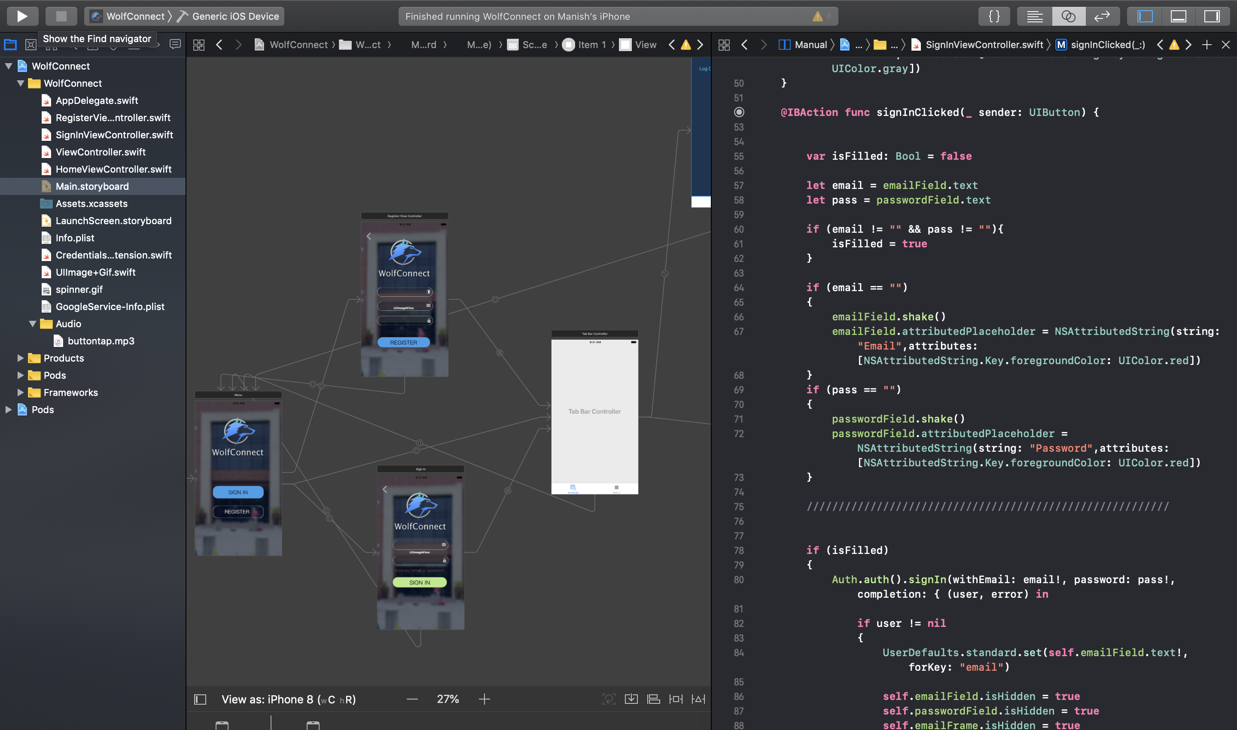
Development:
Apple’s Xcode and Swift

Slide 6
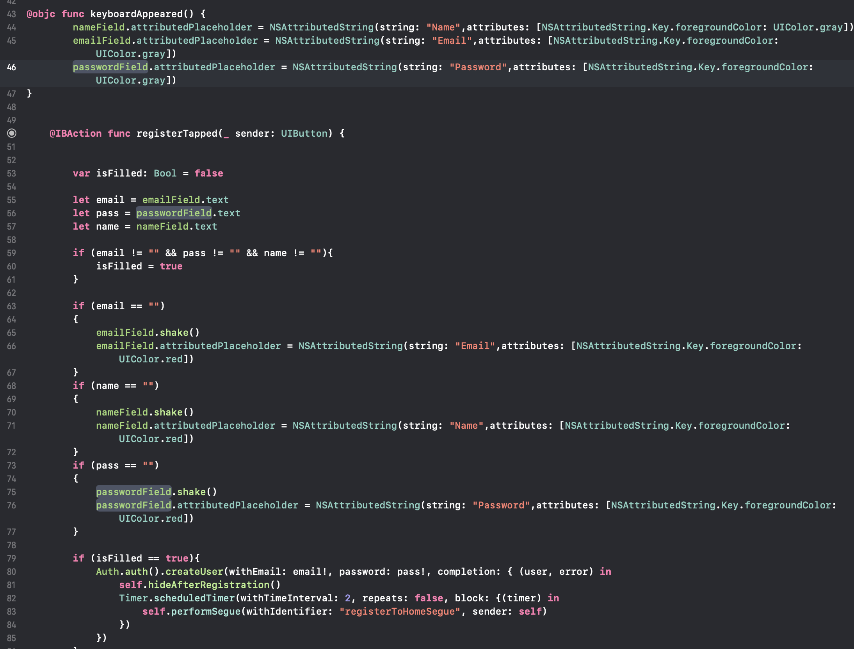

Slide 7
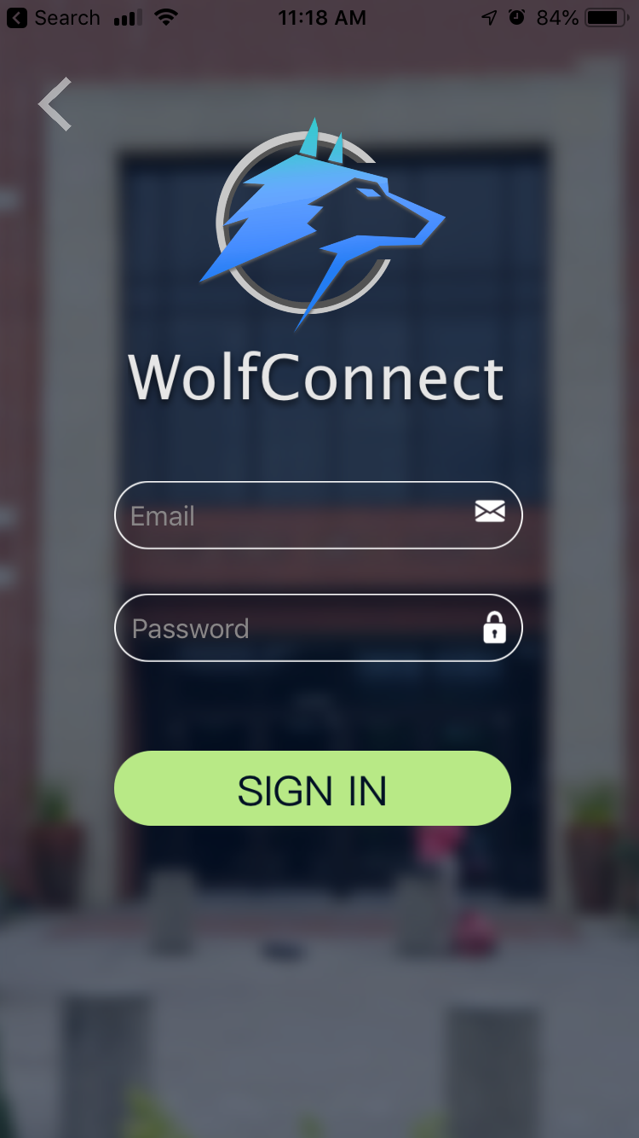
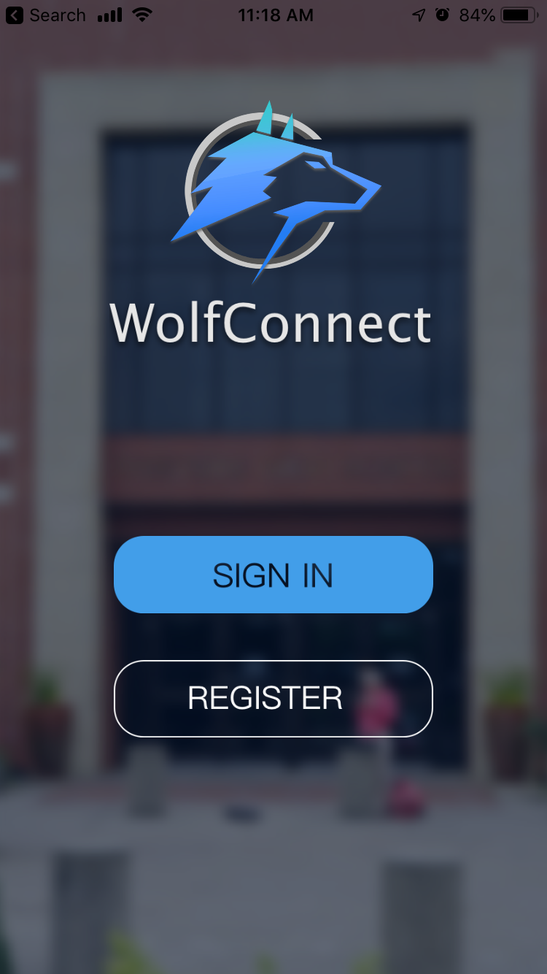
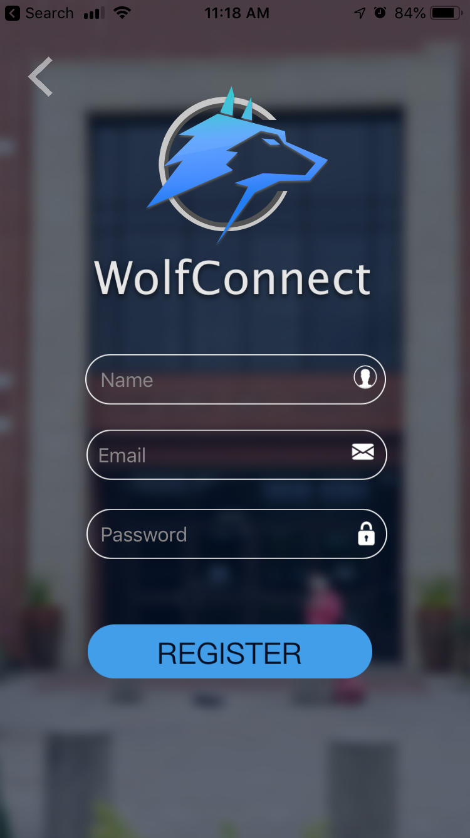
User Login

Slide 8

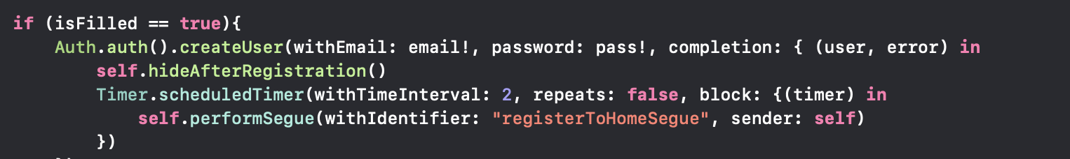
Firebase Authorization System
The Firebase Authentication SDK
Authenticate users with their email addresses and passwords.
Firebase Authentication uses a easy-to-use SDKs, and ready-made UI libraries to authenticate users to the app

Slide 9
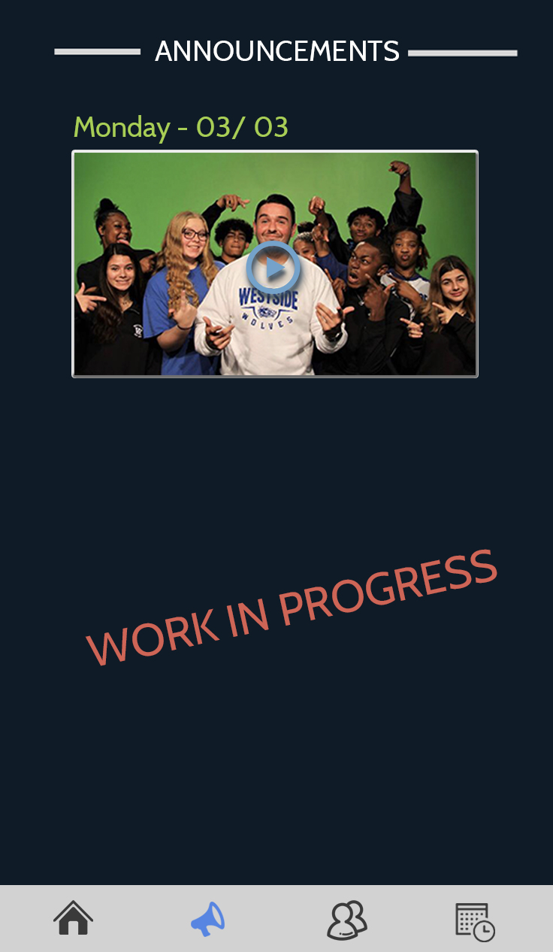
Announcements
Daily HowlerTV morning broadcast
News and updates
Upcoming events

Slide 10
Schedule
Easily accessible class schedules
Updated weekly
Clean interface

Slide 11
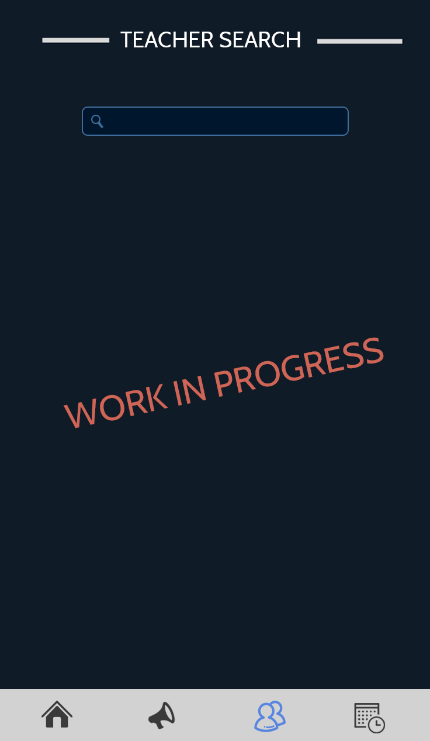
Teacher Information
Access:
Class syllabus
Courses taught
Teacher contact information (email)
Tutorial hours
Built-in email system (schedule appointments, ask questions, etc.)

Slide 12
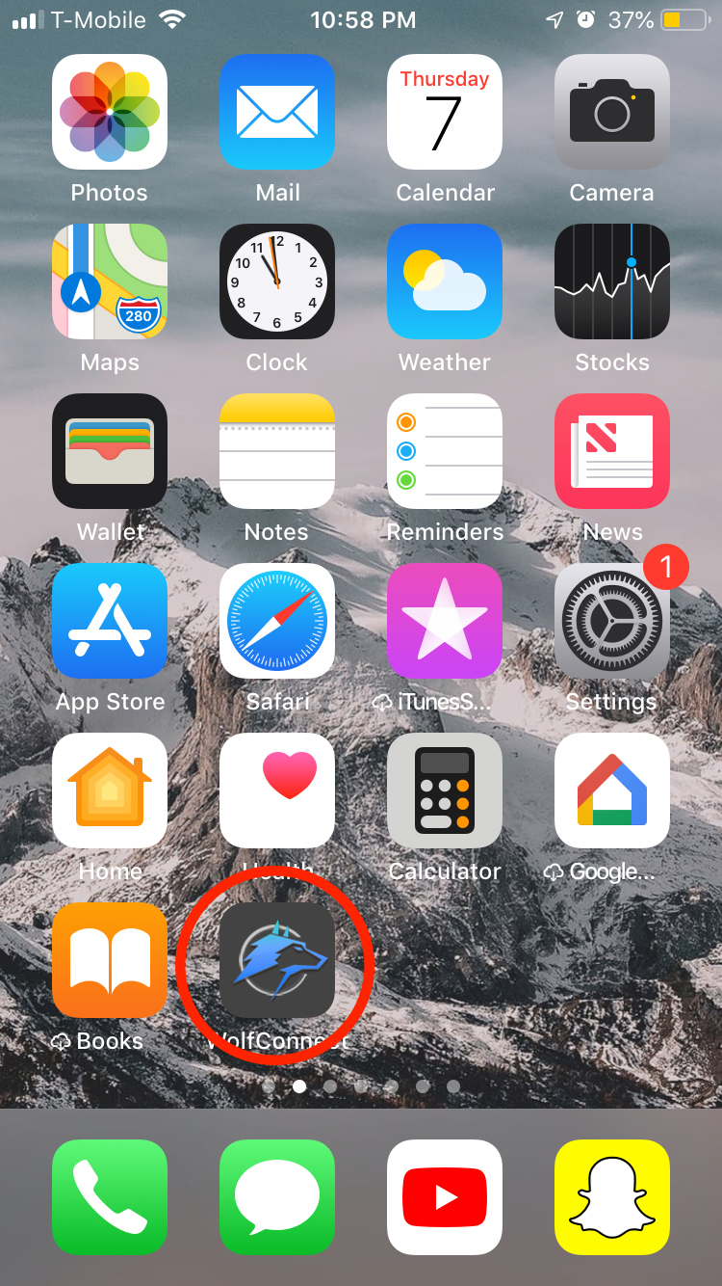
Deployment
TBD

